Slide 1
Link State Routing
A Link State Routing Algorithm is a type of routing algorithm used in computer networks to determine the shortest path from one node to another. It operates by constructing a complete topological map of the network, representing each node and link, and then using this map to calculate the shortest paths.
Link state routing protocol is a type of network routing protocol. It maps the entire network, including the routers and the links between them. This map is called the link state database or topology table. The LSDB(Link State Database) is a very important component of a Link State Routing Protocol.
It is a data structure that stores the topology of a network as known by a specific router running a Link State Routing Protocol.
Link state routing protocols exchange LSAs(Link State Advertisements) between routers. It contains information about the state of the links connected to each router. The LSAs are used to build and maintain a complete and up-to-date network map. It enables routers to calculate the shortest path to a destination.

Slide 2
Phases of Link State Routing
Flooding Phase :
In this phase, each router floods its own LSA to all other routers in the network.
The LSA contains information about the router's own links. It also contains the state of its neighboring routers. Routers use the LSA to build their own LSDB and to update the database as changes occur in the network.
Calculation Phase:
Once each router has received all LSAs from its neighbors and has built its own LSDB, it performs a shortest-path-first (SPF) calculation. It performs SPF to determine the best path to each destination in the network.
The SPF calculation considers the cost of each link. It also considers the state of each router in the LSDB. The result of the SPF calculation is used to build the forwarding table. This table contains the best path to each destination. This table is used to forward packets to their intended destination.
These two phases are continuous and occur simultaneously in the link state routing protocol. Routers continue to flood LSAs and update their LSDBs as changes occur in the network. They recalculate the SPF algorithm to determine the best path to each destination based on the most up-to-date network topology information.

Slide 3
Algorithm for Link State Routing
Discovery phase: Each router sends out Hello packets to discover its neighbors and to establish a neighbor adjacency. Once a neighbor adjacency is established, routers exchange LSAs to learn about the state of the network.
LSA flooding: Each router floods its own LSA to all other routers in the network. The LSA consists of information about the router's own links and the state of its neighboring routers. Routers use the LSA to build their own LSDB and to update the database as changes occur in the network.
Shortest Path First (SPF) calculation: Once each router has received all LSAs from its neighbors and has built its own LSDB, it performs an SPF calculation which determines the best path to each destination in the network. The SPF calculation considers the cost of each link and the state of each router in the LSDB. The result of the SPF calculation is used to build the forwarding table. This table contains the best path to each destination. This table is used to forward packets to their intended destination.
Updating LSAs: When a change occurs in the network, such as a link failure or adding a new router, the affected router floods a new LSA to all other routers in the network. This triggers a recalculation of the SPF algorithm, and the forwarding table is updated to reflect the new best path to each destination.
Aging LSAs: To prevent outdated LSAs from remaining in the LSDB, each router assigns a time-to-live (TTL) value to each LSA. When the TTL value expires, the router removes the LSA from its LSDB.

Slide 4
Link State Routing
Discover its neighbors and learn their network addresses.
Set the distance or cost metric to each of its neighbors.
Construct a packet telling all it has just learned.
Send this packet to and receive packets from all other routers.
Compute the shortest path to every other router
The complete topology is distributed to every router. Then Dijkstra’s algorithm can be run at each router to find the shortest path to every other router.

Slide 5
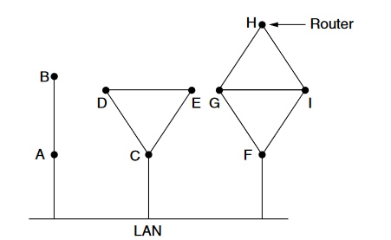
Link State Routing
Learning about the Neighbors:
When a router is booted, its first task is to learn who its neighbours are. It accomplishes this goal by sending a special HELLO packet on each point-to-point line.
The router on the other end is expected to send back a reply giving its name. These names must be globally unique because when a distant router later hears that three routers are all connected to F, it is essential that it can determine whether all three mean the same F.
When two or more routers are connected by a broadcast link (e.g., a switch, ring, or classic Ethernet), the situation is slightly more complicated.
The figure illustrates a broadcast LAN to which three routers, A, C, and F, are directly connected. Each of these routers is connected to one or more additional routers, as shown.

Slide 6
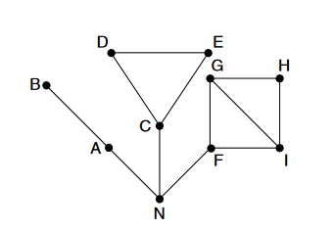
Link State Routing
The broadcast LAN provides connectivity between each pair of attached routers.
However, modeling the LAN as many point-to-point links increases the size of the topology and leads to wasteful messages.
A better way to model the LAN is to consider it as a node itself, as shown in figure.
Here, we have introduced a new, artificial node, N, to which A, C, and F are connected.
One designated router on the LAN is selected to play the role of N in the routing protocol.
The fact that it is possible to go from A to C on the LAN is represented by the path ANC here.

Slide 7
Link State Routing
Setting Link Costs
The link state routing algorithm requires each link to have a distance or cost metric for finding shortest paths.
The cost to reach neighbors can be set automatically, or configured by the network operator. A common choice is to make the cost inversely proportional to the bandwidth of the link.
For example, 1-Gbps Ethernet may have a cost of 1 and 100-Mbps Ethernet a cost of 10. This makes higher-capacity paths better choices.
If the network is geographically spread out, the delay of the links may be factored into the cost so that paths over shorter links are better choices.
The most direct way to determine this delay is to send over the line a special ECHO packet that the other side is required to send back immediately.
By measuring the round-trip time and dividing it by two, the sending router can get a reasonable estimate of the delay.

Slide 8
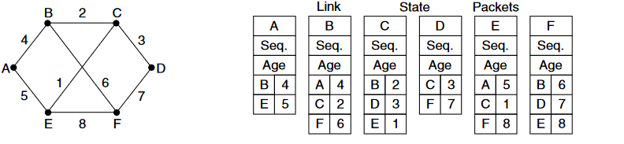
Link State Routing-Example1
Building Link State Packets
Once the information needed for the exchange has been collected, the next step is for each router to build a packet containing all the data.
The packet starts with the identity of the sender, followed by a sequence number and age and a list of neighbors.

Slide 9
Link State Routing
Building Link State Packets :
Building the link state packets is easy. The hard part is determining when to build them. One possibility is to build them periodically, that is, at regular intervals.
Another possibility is to build them when some significant event occurs, such as a line or neighbor going down or coming back up again or changing its properties appreciably.
Distributing the Link State Packets :
The trickiest part of the algorithm is distributing the link state packets. All of the routers must get all of the link state packets quickly and reliably.
If different routers are using different versions of the topology, the routes they compute can have inconsistencies such as loops, unreachable machines, and other problems.
The fundamental idea is to use flooding to distribute the link state packets to all routers. To keep the flood in check, each packet contains a sequence number that is incremented for each new packet sent. Routers keep track of all the (source router, sequence) pairs they see.

Slide 10
Link State Routing
Distributing the Link State Packets :
When a new link state packet comes in, it is checked against the list of packets already seen. If it is new, it is forwarded on all lines except the one it arrived on. If it is a duplicate, it is discarded.
If a packet with a sequence number lower than the highest one seen so far ever arrives, it is rejected as being obsolete as the router has more recent data.
This algorithm has a few problems, but they are manageable. First, if the sequence numbers wrap around, confusion will reign.
The solution here is to use a 32-bit sequence number. With one link state packet per second, it would take 137 years to wrap around, so this possibility can be ignored.
Second, if a router ever crashes, it will lose track of its sequence number. If it starts again at 0, the next packet it sends will be rejected as a duplicate.
Third, if a sequence number is ever corrupted and 65,540 is received instead of 4 (a 1-bit error), packets 5 through 65,540 will be rejected as obsolete, since the current sequence number will be thought to be 65,540.

Slide 11
Link State Routing
The solution to all these problems is to include the age of each packet after the sequence number and decrement it once per second.
When the age hits zero, the information from that router is discarded. Normally, a new packet comes in, say, every 10 sec, so router information only times out when a router is down (or six consecutive packets have been lost, an unlikely event).
The Age field is also decremented by each router during the initial flooding process, to make sure no packet can get lost and live for an indefinite period of time (a packet whose age is zero is discarded).
Some refinements to this algorithm make it more robust. When a link state packet comes in to a router for flooding, it is not queued for transmission immediately.
Instead, it is put in a holding area to wait a short while in case more links are coming up or going down.
If another link state packet from the same source comes in before the first packet is transmitted, their sequence numbers are compared.
If they are equal, the duplicate is discarded. If they are different, the older one is thrown out. To guard against errors on the links, all link state packets are acknowledged.

Slide 12
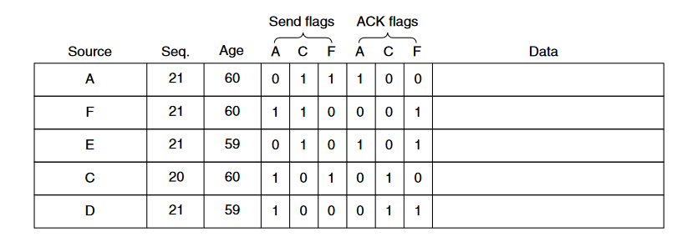
Link State Routing
The data structure used by router B for the network shown in figure. Each row here corresponds to a recently arrived, but as yet not fully processed, link state packet.
The table records where the packet originated, its sequence number and age, and the data. In addition, there are send and acknowledgement flags for each of B’s three links (to A, C, and F, respectively).
The send flags mean that the packet must be sent on the indicated link. The acknowledgement flags mean that it must be acknowledged there.

Slide 13
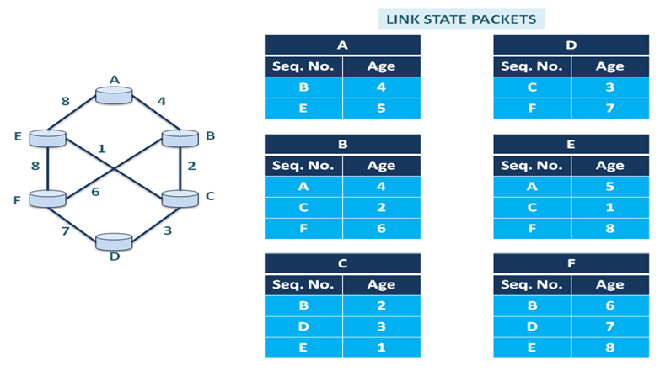
Link State Routing Protocol Example2

Slide 14
Link State Routing
The link state packet from A arrives directly, so it must be sent to C and F and acknowledged to A, as indicated by the flag bits.
Similarly, the packet from F has to be forwarded to A and C and acknowledged to F.
However, the situation with the third packet, from E, is different. It arrives twice, once via EAB and once via EFB.
Consequently, it has to be sent only to C but must be acknowledged to both A and F, as indicated by the bits.
If a duplicate arrives while the original is still in the buffer, bits have to be changed.
For example, if a copy of C’s state arrives from F before the fourth entry in the table has been forwarded, the six bits will be changed to 100011 to indicate that the packet must be acknowledged to F but not sent there.

Slide 15
Link State Routing
Computing the New Routes :
Once a router has accumulated a full set of link state packets, it can construct the entire network graph because every link is represented.
Every link is, in fact, represented twice, once for each direction. The different directions may even have different costs.
The shortest-path computations may then find different paths from router A to B than from router B to A.
Now Dijkstra’s algorithm can be run locally to construct the shortest paths to all possible destinations.
The results of this algorithm tell the router which link to use to reach each destination. This information is installed in the routing tables, and normal operation is resumed.
Compared to distance vector routing, link state routing requires more memory and computation.
For a network with n routers, each of which has k neighbors, the memory required to store the input data is proportional to kn, which is at least as large as a routing table listing all the destinations.

Slide 16
Link State Routing
Computing the New Routes :
The computation time grows faster than kn, even with the most efficient data structures, an issue in large networks.
Nevertheless, in many practical situations, link state routing works well because it does not suffer from slow convergence problems.
Link state routing is widely used in actual networks, so a few words about some example protocols are in order.
Many ISPs use the IS-IS (IntermediateSystem-Intermediate System) link state protocol (Oran, 1990).
It was designed for an early network called DECnet, later adopted by ISO for use with the OSI protocols and then modified to handle other protocols as well, most notably, IP.
OSPF (Open Shortest Path First) is the other main link state protocol. It was designed by IETF several years after IS-IS and adopted many of the innovations designed for IS-IS.

Slide 17
Link State Routing
Computing the New Routes :
These innovations include a self-stabilizing method of flooding link state updates, the concept of a designated router on a LAN, and the method of computing and supporting path splitting and multiple metrics.
As a consequence, there is very little difference between IS-IS and OSPF.
The most important difference is that IS-IS can carry information about multiple network layer protocols at the same time (e.g., IP, IPX, and AppleTalk).

Slide 18
Link State Routing-Benefits
Each router has a complete network map, link state routing protocols can converge much faster than distance vector protocols, which rely on periodic updates.
Link state routing protocols only send updates when there is a change in the network topology. It reduces the amount of bandwidth used compared to distance vector protocols.
Link state routing protocols are better suited to large networks. They can handle a more significant number of routers and links without suffering from routing loops or other issues.
Examples of link state routing protocols include Open Shortest Path First (OSPF) and Intermediate System to Intermediate System (IS-IS).

Slide 19
Link State Routing-Limitations
Link state routing protocols require more computational power. It requires more memory to maintain the link state database and to perform the shortest path calculation. This can limit their scalability, especially in more extensive networks.
The link state routing protocol is more complex than other routing protocols. This complexity makes the protocol more challenging to configure and manage.
It generates more network traffic than distance vector protocols. It sends frequent updates about changes in the network topology.
These protocols are vulnerable to routing attacks, such as spoofed LSA attacks. It can cause routers to make incorrect routing decisions.

Slide 20
Distance Vector Vs Link State Routing
Parameter | Distance Vector Routing | Link State Routing
Routing Information | Routers share their routing tables with their neighbors. | Routers share information about the entire network topology.
Convergence | Slower convergence. | Faster convergence.
Updates | Periodic updates are sent to neighboring routers. | Updates are triggered by changes in the network topology.
Algorithm | Uses the Bellman-Ford algorithm. | Uses Dijkstra’s algorithm.
Information Storage | Stores only the best path to each destination. | Stores the entire network topology.
Resource Utilization | Lower memory and CPU usage. | Higher memory and CPU usage due to detailed information.
Complexity | Simpler to implement. | More complex to implement.
Scalability | Less scalable due to slow convergence and routing loops. | Highly scalable with faster convergence and no routing loops.
Network Overhead | Can generate more overhead due to frequent updates. | Generally generates less overhead with event-triggered updates.
Routing Loops | Susceptible to routing loops. | Less susceptible to routing loops due to global view.
Example Protocols | RIP (Routing Information Protocol), IGRP (Interior Gateway Routing Protocol). | OSPF (Open Shortest Path First), IS-IS (Intermediate System to Intermediate System).

